Slide 1


University of Cebu Lapu-Lapu and Mandaue
Graduate School
Master of Science in Criminal Justice
with Specialization in Criminology
A Topic Report:
MSCJ 109 - Modern Penology
THE PHILIPPINE CORRECTIONAL SYSTEM: INSTITUTION-BASED CORRECTIONS
Presented to:
Paul Pioquinto
Presented by:
Sacurom, Lovely Mae E.

Slide 2


Modern Penology
01
Learning Objectives
02
Introduction
03
Reflection Presentation
04
Strength
05
Weaknesses
06
Opportunities
07
Threats
Today’s Agenda
08
Conclusion
09
Recommendations
10
References

Slide 3

Modern Penology
Learning Objectives
COGNITIVE
AFFECTIVE
PSYCHOMOTOR
  Focuses on changing criminal thinking.
  Promotes positive behavior and values.
  Improves decision-making skills.
  Encourages personal responsibility.
  Supports rehabilitation and reintegration.
  Develops positive values and attitudes
  Promotes respect for laws and society
  Builds self-discipline and responsibility
  Encourages empathy and accountability
  Supports personal and moral growth
  Develops vocational and technical skills
  Enhances work habits and discipline
  Provides livelihood training
  Promotes productive use of time
  Prepares PDLs for employment after release

Slide 4
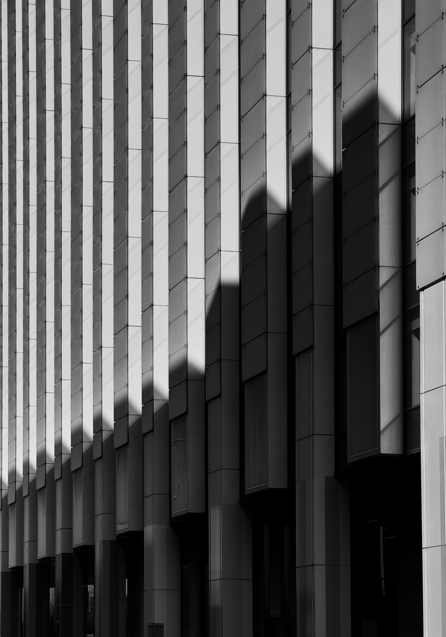

Introduction
  Institution-Based Corrections is a component of the Philippine Correctional System.
  It involves the custody, supervision, and rehabilitation of PDLs in correctional facilities.
  Managed primarily by the Bureau of Corrections (BuCor).
  Focuses on rehabilitation, reintegration, and public safety.
  Aims to transform offenders into productive members of society.

Slide 5

Reflection Presentation
S
W
O
T
Effective offender custody and rehabilitation programs
Overcrowding and limited resources
Modernization, partnerships, and expanded rehabilitation services.
Rising inmate population, security concerns, and social stigma.

Slide 6
Modern Penology
🛡️
Security and Public Protection
🔄
Rehabilitation and Behavior Change
Strength
🤝
Reintegration and Personal Development

Slide 7
Security and Public Protection
  Institution-based corrections keep convicted offenders in secure facilities, preventing them from committing further crimes in the community.
  Correctional institutions maintain order and security through established rules, supervision, and monitoring.
  It helps protect citizens while offenders serve their sentence.

Slide 8
Rehabilitation and Behavior Change
  Inmates are given access to educational programs, literacy classes, vocational training, and spiritual activities
  These programs help develop positive values, discipline, and work skills.
  Rehabilitation reduces the likelihood of offenders returning to criminal activities after release.

Slide 9
Reintegration and Personal Development
  Correctional facilities provide livelihood and skills training that can help inmates find employment after release.
  Programs encourage personal growth, responsibility, and social adjustment.
  Reintegration efforts contribute to reducing recidivism and promoting community stability.

Slide 10

Weaknesses
Overcrowding in Correctional Facilities
Limited Resources and Facilities
Challenges in Rehabilitation Programs

Slide 11
Weaknesses
1
Overcrowding in Correctional Facilities
  Many correctional facilities house more inmates than their intended capacity.
  Overcrowding results in limited space, poor living conditions, and strained resources.
  It becomes difficult to effectively supervise and manage inmates.
  Rehabilitation programs may not reach all inmates due to the large population.

Slide 12
Weaknesses
2
Limited Resources and Facilities
  Some correctional facilities face shortages in personnel, equipment, and rehabilitation resources.
  Aging buildings require maintenance and modernization.
  Limited budgets can affect healthcare, education, and vocational training programs.
  Staff may experience increased workload due to the high inmate population.

Slide 13

Five-Year Improvement in Staffing
Year | Officer-to-PDL Ratio
2021 | 1:40
2022 | 1:29
2023 | 1:26
2024 | 1:24
2025 | 1:20

Slide 14
Weaknesses
3
Challenges in Rehabilitation Programs
  Not all inmates can participate in educational and vocational programs.
  Rehabilitation activities may vary depending on facility capacity and resources.
  Some inmates may leave prison without sufficient preparation for reintegration.
  This can contribute to repeat offenses or difficulties in adapting to society.

Slide 15

Modern Penology
Opportunities
MODERNIZATION OF CORRECTIONAL FACILITIES
PARTNERSHIPS AND COMMUNITY SUPPORT
EXPANSION OF REHABILITATION PROGRAMS

Slide 16

Modernization of Correctional Facilities
  Modernize prison facilities to improve living conditions and security.
  Adopt digital record management systems for efficient inmate monitoring.
  Improve healthcare, sanitation, and housing within correctional institutions.
  Enhance safety for both inmates and correctional personnel.

Slide 17
Expansion of Rehabilitation Programs
  Expand educational and vocational training programs.
  Offer more livelihood opportunities and skills certification.
  Increase access to counseling, mental health, and behavioral interventions.
  Equip inmates with skills needed for employment after release.

Slide 18
Partnerships and Community Support
  Partner with NGOs, educational institutions, and private organizations.
  Develop employment opportunities for former inmates.
  Encourage community-based reintegration programs.
  Promote public awareness to reduce stigma against ex-offenders.

Slide 19
Threats
01
Increasing Inmate Population
02
Security Risks and Prison Violence
Social Stigma and Reintegration Barriers
03

Slide 20
Increasing Inmate Population
01
  Rising crime rates and court convictions may increase the number of inmates.
  Facilities may become more congested than their intended capacity.
  Overcrowding can strain correctional resources and services.
  It may reduce the effectiveness of rehabilitation programs.

Slide 21
Security Risks and Prison Violence
02
  Presence of gangs and organized inmate groups within facilities.
  Smuggling of contraband such as illegal drugs and weapons.
  Potential for inmate violence, riots, and security breaches.
  Threats can endanger inmates, correctional officers, and facility operations.

Slide 22
Social Stigma and Reintegration Barriers
03
  Former inmates often face discrimination in employment and social acceptance.
  Limited job opportunities may make reintegration difficult.
  Lack of community support can affect successful rehabilitation.
  These challenges may increase the risk of recidivism or reoffending.

Slide 23
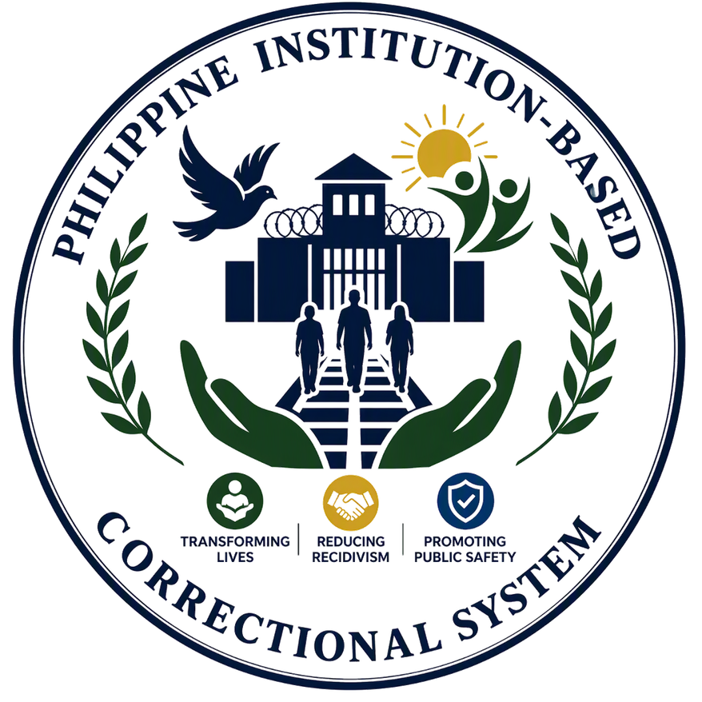
Conclusion
The Philippine Institution-Based Correctional System remains an essential part of the criminal justice system. While it faces challenges such as overcrowding and limited resources, it continues to provide opportunities for offender rehabilitation and reform. Through continuous improvement, effective programs, and community support, the correctional system can better fulfill its mission of transforming lives, reducing recidivism, and promoting public safety.

Slide 24
Recommendations
1
2
3
4
Address Prison Overcrowding
Enhance Rehabilitation Programs
Modernize Correctional Facilities
Strengthen Reintegration Efforts

Slide 25
References
Bureau of Corrections. (n.d.). Mandates and Functions. https://bucor.gov.ph/?page_id=2304
Bureau of Corrections. (n.d.). Mission and Vision. https://bucor.gov.ph/?page_id=2305
Department of Justice. (n.d.). Bureau of Corrections. https://www.doj.gov.ph/agencies.html [doj.gov.ph]
Republic Act No. 10575. (2013). Bureau of Corrections Act of 2013.
https://lawphil.net/statutes/repacts/ra2013/ra_10575_2013.html

Slide 26
Modern Penology
Thank You
945-283-4808
EL LEe Sacurom
for your time and attention
leesacurom03@gmail.com
Banilad, Cebu City

